Slide 1
Automated Timetable Scheduling for Classes and Exams
CS 309: Research and Development Project
Cebajel Tanan
210010055

Slide 2
Outline
Background and Motivation
Class Timetable
Problem Statement
Proposed Approach
Performance Evaluation
Exam Timetable
Problem Statement
Proposed Approach
Challenges and Learnings
Closing Remarks

Slide 3
Background and Motivation
Timetable scheduling is an age-old problem
Applicable for both classes and exams
Typically done manually
Time-consuming across several stakeholders
Academic Office Staff
Department Heads, Timetable Coordinators
Multiple meetings and iterations
Prone to human errors/oversight
NP-hard
Existing approaches
Optimization
Optimal, but time-consuming
Heuristics
Sub-optimal, but fast
Existing solutions
Typically, school/college/university-specific
Rarely universally applicable
IIT Dharwad’s unique scheduling requirements
HSS Baskets
Multiple Campus
Minor Slot
Slots of various sizes (1, 2, 3, and 4 hours)
Need for automated scheduling
Save time
Minimize errors
Specific to IIT Dharwad

Slide 4

Problem Statement – Class Timetable
Input
List of elective courses
With student elective preferences
List of core courses
Across programs/batches with corresponding students
Divisions per course
List of venues
With capacity, type, campus
List of courses
With student list, type (lab/theory)
List of campuses
Number of slots per day
With duration(s)
Number of usable weekdays
Output
Mapping
Courses $↔$ Slot/day $↔$ Venue
Objective
Maximize the number of student elective preferences met

Slide 5
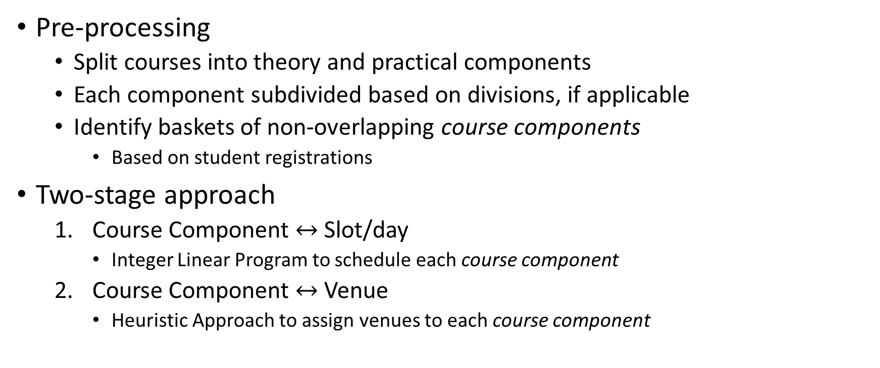
Proposed Approach
Pre-processing
Split courses into theory and practical components
Each component subdivided based on divisions, if applicable
Identify baskets of non-overlapping course components
Based on student registrations
Two-stage approach
Course Component $↔$ Slot/day
Integer Linear Program to schedule each course component
Course Component $↔$ Venue
Heuristic Approach to assign venues to each course component

Slide 6
Notations

Slide 7
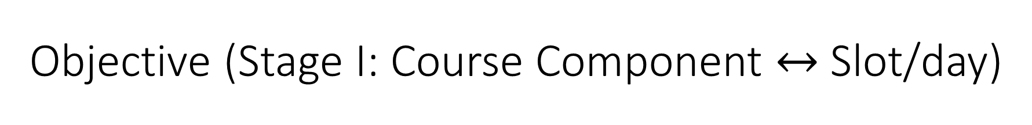
Objective (Stage I: Course Component $↔$ Slot/day)

Slide 8
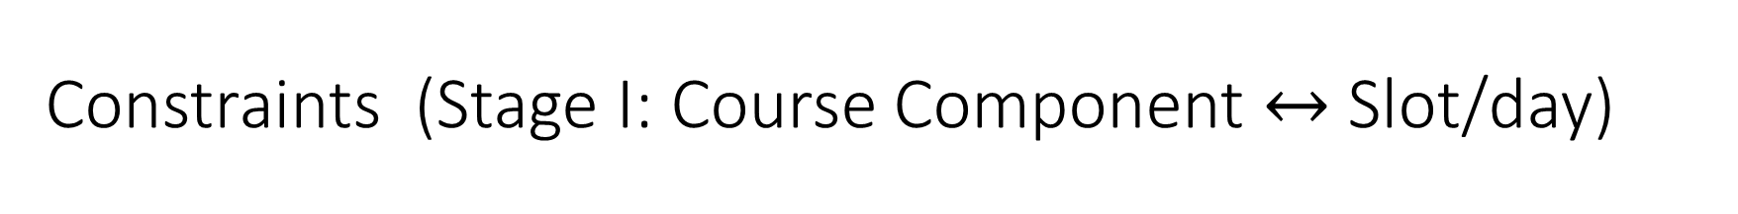
Constraints (Stage I: Course Component $↔$ Slot/day)

Slide 9
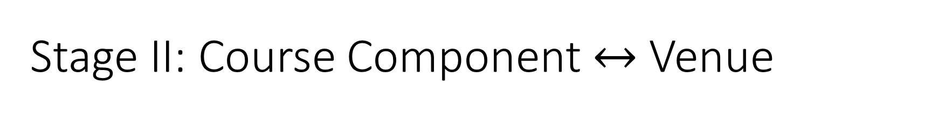
Stage II: Course Component $↔$ Venue

Slide 10
Performance Evaluation (Class Timetable)
Modeled using Gurobi on Apple M1 Pro processor (3.2 GHz)
with 16GB RAM
Test data
Autumn 2023 Timetable data
7610 enrollments
125 courses
Runtime
Feasible solution in 30 seconds
Found optimal solution in about an hour
About 50 student elective preferences could not be met

Slide 11
Discrepancies in the ongoing timetable
Failed to accommodate 525 student elective preferences
Students with courses across both campuses in consecutive slots
LTP requirements not met for a few courses
Overprovisioned venues

Slide 12
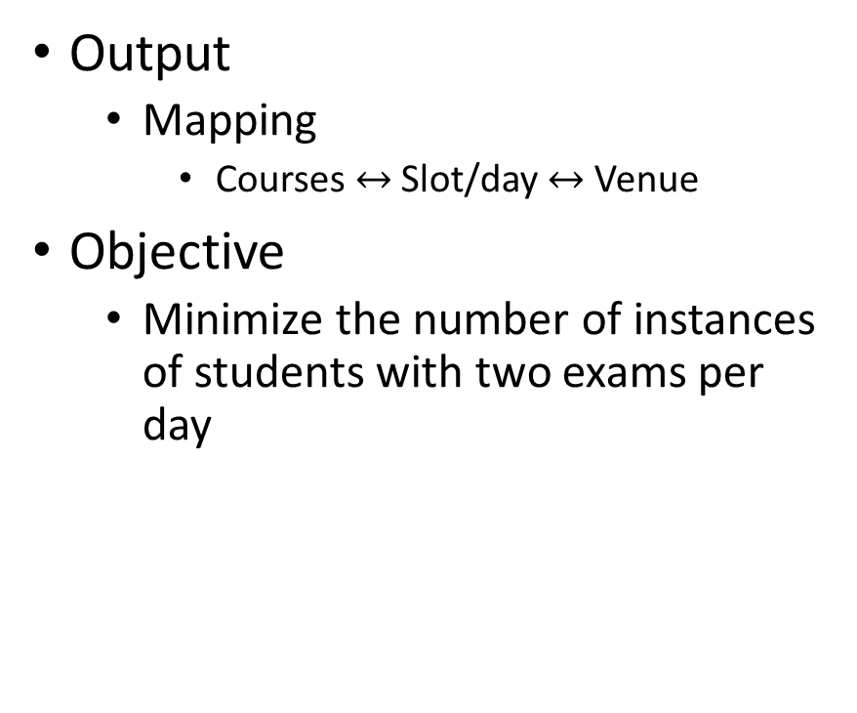
Problem Statement – Exam Timetable
Input
List of courses
With student registrations, preferred campus
List of venues
With capacity, type, campus
List of campuses
Number of slots per day
With duration(s)
Number of usable weekdays
Output
Mapping
Courses $↔$ Slot/day $↔$ Venue
Objective
Minimize the number of instances of students with two exams per day

Slide 13
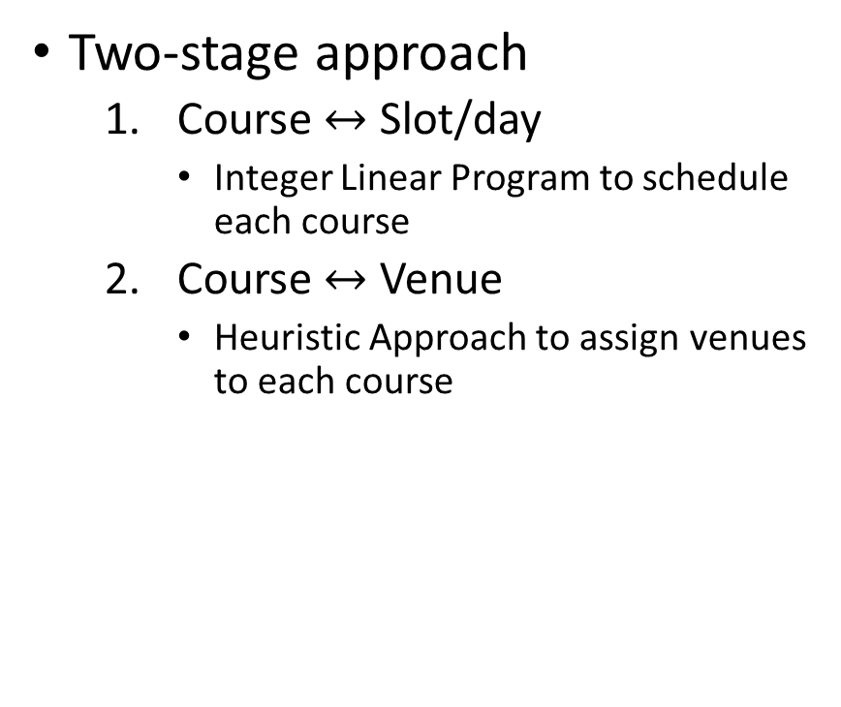
Proposed Approach
Analogous to Class Timetable with the following caveats
Exam = Course with LTPC: 1-0-0-2
Two slots per day
Pre-processing
Identify baskets of non-overlapping courses
Based on student registrations
Two-stage approach
Course $↔$ Slot/day
Integer Linear Program to schedule each course
Course $↔$ Venue
Heuristic Approach to assign venues to each course

Slide 14

Notations (Stage I: Course $↔$ Slot/day)

Slide 15

Objective (Stage I: Course $↔$ Slot/day)

Slide 16

Constraints (Stage I: Course $↔$ Slot/day)

Slide 17
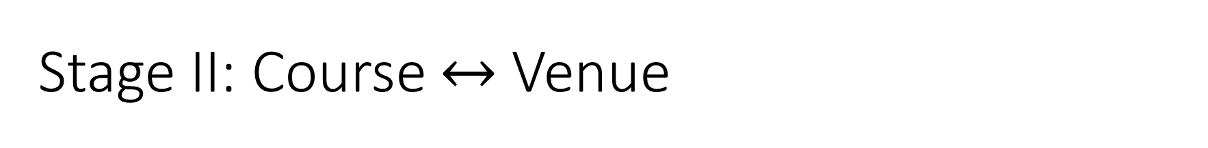
Stage II: Course $↔$ Venue

Slide 18
Performance Evaluation (Exam Timetable)
Modeled using Gurobi on Apple M1 Pro processor (3.2 GHz) and 16GB RAM.
Mid-sem Timetable Data
Runtime
Feasible solution in 3 seconds
Optimal solution in 15 seconds
Optimal solution
14 pairs of same-day different-slot exams with at least one student

Slide 19
Challenges and Learnings
Getting clean and consistent data
Reducing the number of slots, days
Reducing the runtime of the formulation/model
Feasible solution: From 10 minutes to half a minute
Optimal solution: From 8 hours to about an hour
Implemented parallelization and dynamic programming
Optimized constraints by simplifying structure without compromising functionality
Experimented with various strategies, reducing decision variable dimensionality most effective

Slide 20
Closing Remarks
Conclusion
Developed an efficient framework for resolving and optimizing timetable scheduling problems.
Foresee its utility in academic research and as a public welfare resource
Future Work
Explore Heuristic Approaches
Draft exam timetable based on class timetable (and not from scratch)
Derive baskets of overlapping/non-overlapping courses based on previous timetables, instead of pre-registration data

Slide 21
Thank you
Questions?

